Slide 1


NEXT GEN EMPLOYABILITY PROGRAM
CREATING A FUTURE-READY WORKFORCE
Student Name :
RASHMITHA POTNURU
Student ID :
College Name :
STU64f059d0dfb4e1693473232
MVGR COLLEGE OF ENGINEERING Vizianagaram

Slide 2
CAPSTONE PROJECT SHOWCASE
Project Title
Recipe Sharing Platform with React and ExpressJS
Abstract | Problem Statement | Project Overview | Proposed Solution | Technology Used | Modelling & Results | Conclusion | Q&A

Slide 3
Abstract
1
This platform transforms the way food lovers share and discover recipes by providing a digital space for users to create, store, and explore a diverse collection of dishes from around the world.
2
Built using MongoDB, Express.js, React.js, and Node.js, the platform ensures a smooth, fast, and responsive interface with real-time updates, making recipe sharing effortless.
3
Users can upload recipes, add ingredients, share cooking tips, and engage with the community through likes, comments, and favorites. A powerful search and filter system helps users find exactly what they need.
4
Planned upgrades include AI-powered recipe recommendations, dietary preference filters, and video-based tutorials, making it an intelligent and comprehensive cooking assistant.

Slide 4


Problem Statement
Lack of a Unified, Interactive Recipe-Sharing Space
Traditional recipe-sharing methods are scattered across various blogs, social media, and printed cookbooks. There is no single, dedicated platform that allows users to easily create, store, and share recipes while engaging with a community of food enthusiasts.
Difficulty in Finding Personalized Recipes
Existing platforms often lack powerful search and filter features that help users find recipes based on ingredients, cuisine, dietary preferences, or cooking time. Many users struggle to discover recipes that fit their specific needs.

Slide 5

Project Overview
The Recipe Sharing Platform is a modern web-based application designed to revolutionize the way people discover, create, and share recipes. Built using the MERN stack (MongoDB, Express.js, React.js, and Node.js), the platform provides an interactive and user-friendly experience, allowing food enthusiasts to upload, store, and explore a wide variety of recipes. With seamless authentication and secure data management, users can create personal profiles, save their favorite recipes, and interact with others through likes, comments, and discussions.

Slide 6
Proposed Solution
To address the challenges faced by food enthusiasts in finding, organizing, and sharing recipes, the Recipe Sharing Platform provides a centralized, interactive, and intelligent solution. This web-based application allows users to easily create, store, and explore recipes while fostering a strong community of home cooks and culinary professionals.
The platform is built using the MERN stack (MongoDB, Express.js, React.js, and Node.js) to ensure a responsive, scalable, and real-time experience. Users can register securely with JWT-based authentication and manage their personal profiles, where they can upload recipes, add images, write descriptions, and categorize their dishes. A powerful search and filter system helps users find recipes based on ingredients, cuisine type, cooking time, and dietary preferences.To enhance engagement, the platform includes social features like likes, comments, and sharing options, creating a dynamic, interactive community where users can discuss modifications, exchange cooking tips, and provide feedback. The integration of real-time updates ensures that any changes or interactions are immediately reflected, making collaboration seamless.
Security and data integrity are prioritized through role-based access control, encrypted data storage, and regular backups to prevent unauthorized modifications or content loss. In the future, the platform aims to introduce AI-powered personalized recipe recommendations, automated grocery lists, and video-based tutorials, making it a comprehensive, smart, and user-friendly solution for food lovers worldwide.

Slide 7
Technology used
MongoDB: A NoSQL database used to store user data, recipes, images, and interactions efficiently. It offers high scalability and flexibility for handling structured and unstructured data.
Express.js: A lightweight Node.js framework that simplifies backend development, handling server requests, API endpoints, and authentication processes.
React.js: A powerful frontend library that ensures a smooth and dynamic user interface with real-time updates, enhancing user experience.
Node.js: A runtime environment that enables server-side JavaScript execution, allowing efficient handling of multiple requests and ensuring a seamless connection between the frontend and backend.
Additional Technologies & Tools:
JWT (JSON Web Token): For secure user authentication and authorization.
Cloudinary / Firebase Storage: For storing and managing recipe images.
Redux / Context API: For state management and handling global data flow.
Bootstrap / Tailwind CSS: For responsive and visually appealing UI design.
Socket.io (Optional): For enabling real-time interactions like live updates and notifications.

Slide 8
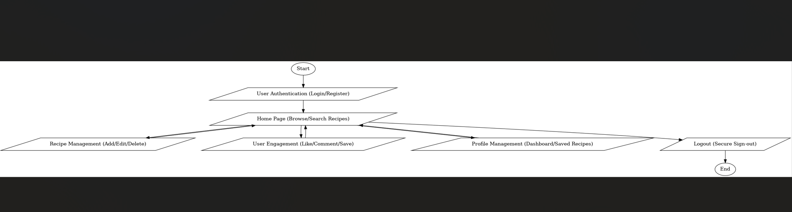
Modelling & Result

Slide 9
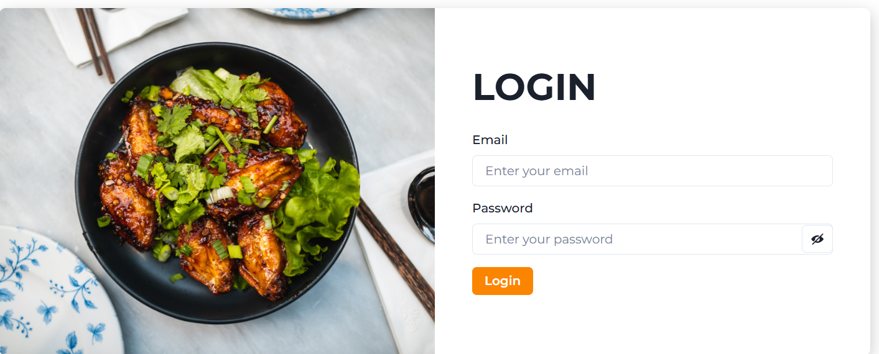
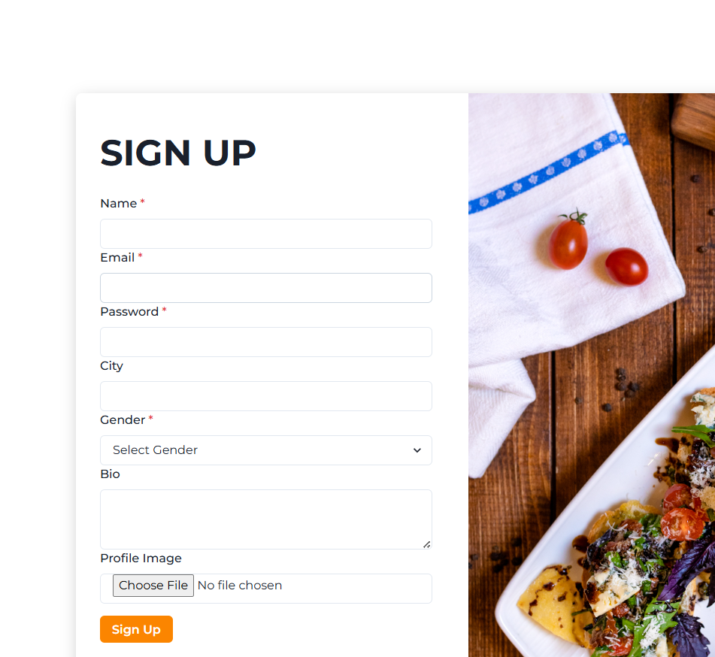
Modelling & Result

Slide 10
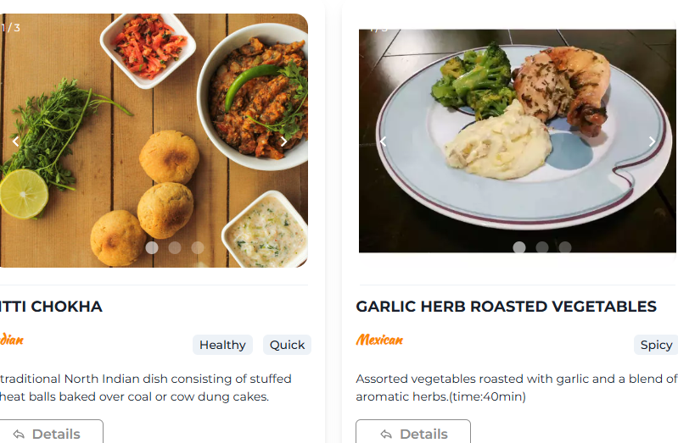
Modelling & Result

Slide 11
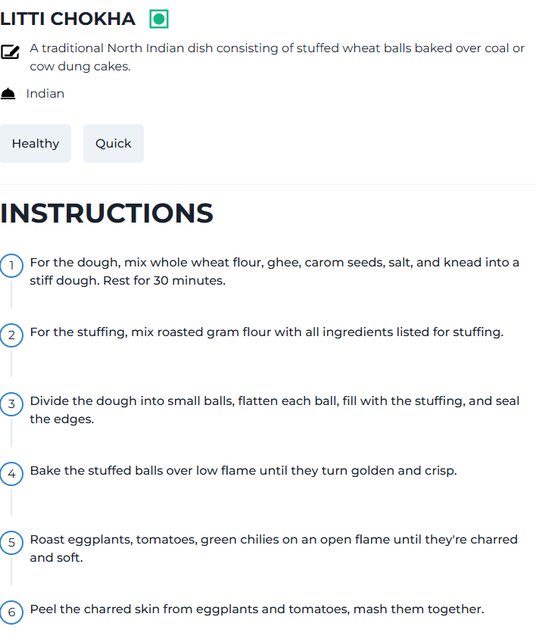
Modelling & Result

Slide 12
Modelling & Result
1. Data Modeling & Database Structure
The platform utilizes MongoDB as a NoSQL database, structuring data into collections and documents. The key entities modeled include:
Users: Stores user profiles, authentication details, and preferences.
Recipes: Contains details such as title, ingredients, instructions, images, cooking time, and user associations.
Interactions: Tracks likes, comments, and shares to facilitate community engagement.
2. Backend Processing & API Design
Using Node.js and Express.js, the backend was structured to handle:
User authentication & authorization (JWT-based security).
RESTful APIs for CRUD (Create, Read, Update, Delete) operations on recipes and interactions.
Middleware for validation, error handling, and security enhancements.
3. Frontend Implementation & UI/UX
The React.js frontend ensures an interactive and responsive user experience. Key components include:
Recipe Display & Filtering System: Users can search and filter recipes based on ingredients, categories, and dietary preferences.
User Dashboard: Personalized space where users can manage their own recipes, saved favorites, and profile settings.
Real-Time Engagement: Features like live commenting and instant updates enhance user interaction.
4. Performance & Scalability Results
Through testing and optimization, the platform demonstrates:
Fast response times (~100-300ms API calls).
Efficient handling of concurrent users with database indexing & caching.
Optimized image storage & lazy loading to improve page speed.
5. Future Enhancements & AI Integration
The platform is designed to integrate AI-powered recipe recommendations, voice-assisted cooking guides, and automated grocery list generation in the future, further enriching user experience.

Slide 13

Conclusion
The Recipe Sharing Platform provides a seamless and interactive space for users to create, share, and explore recipes with real-time engagement. Built using the MERN stack, it ensures a secure, scalable, and user-friendly experience. With future AI integration and advanced features, the platform aims to redefine digital cooking and foster a vibrant food community.
Github:-https://github.com/Rashmitha0218/recipe-sharing.git

Slide 14


Notes:
Thank You !!

